Slide 1
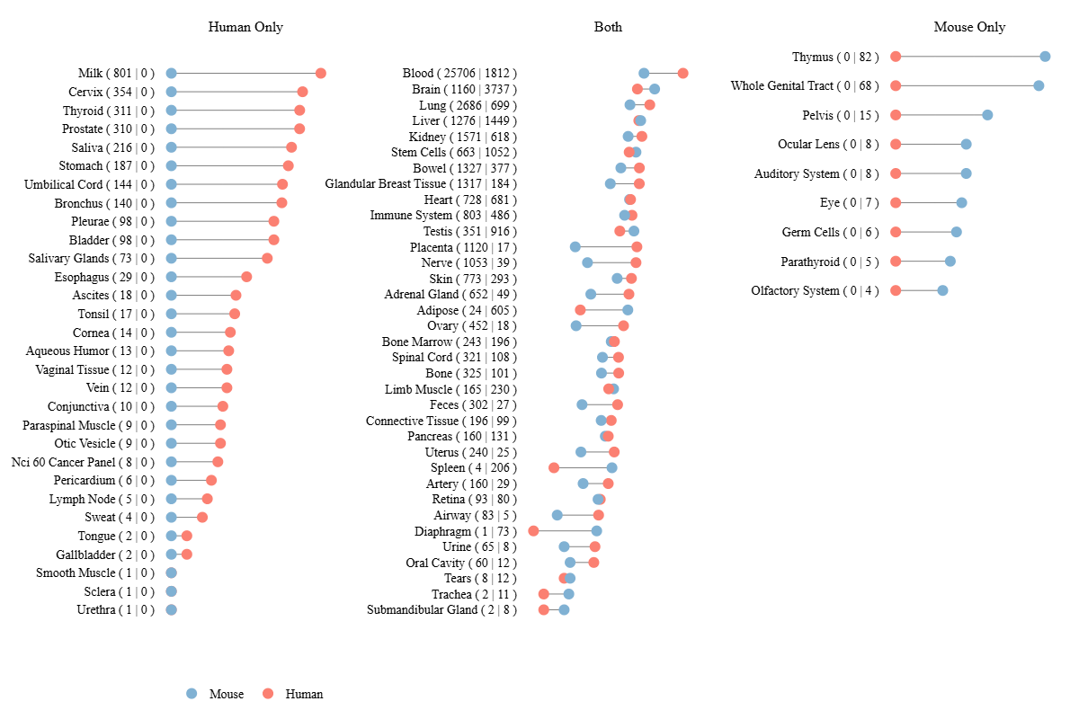
Organ-specific miRNA sequence databases:
miRNA TissueAtlas v3 (2025) :
Shows the expression pattern of a miRNA across different tissues, indicating where and how strongly it is expressed.

Slide 2
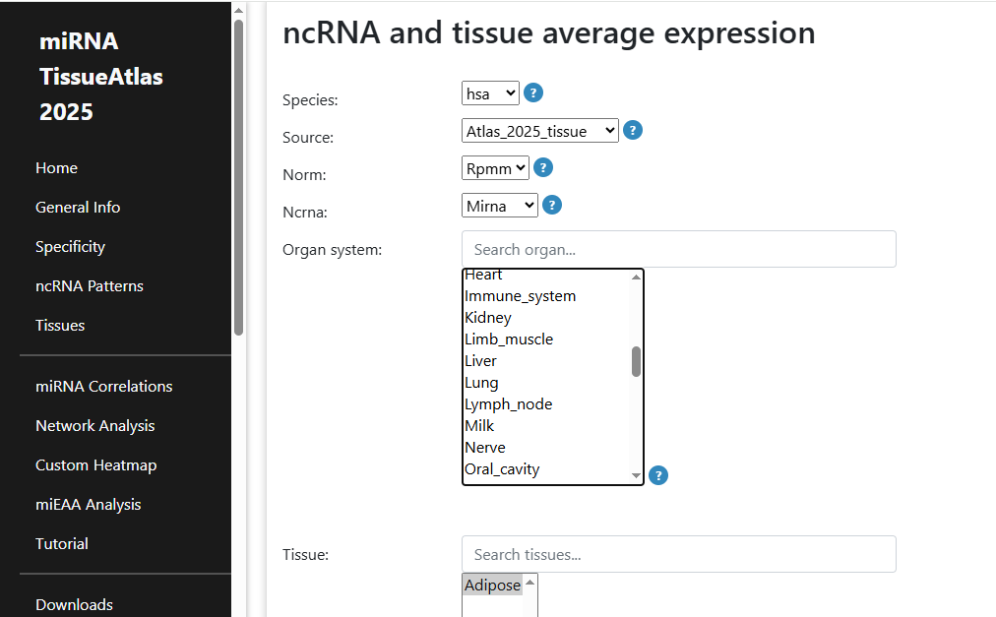

Slide 3
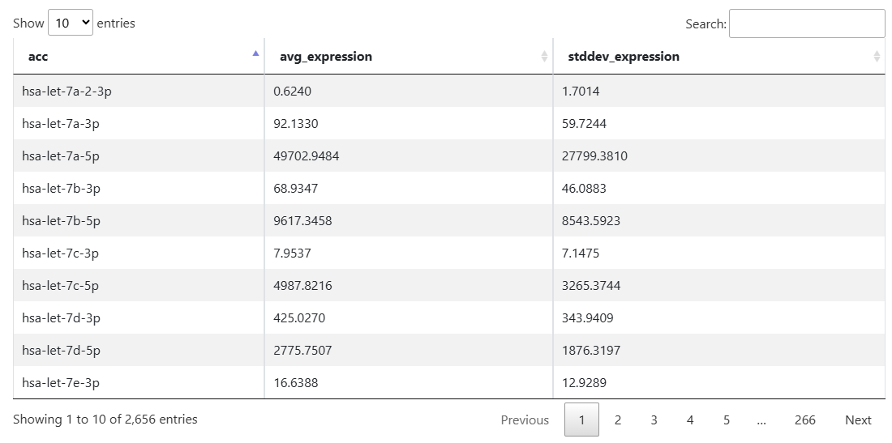
RPMM Range | Expression Level
>10,000 | Very High
1,000 – 10,000 | High
100 – 1,000 | Moderate
10 – 100 | Low
1 – 10 | Very Low
<1 | Negligible

Slide 4
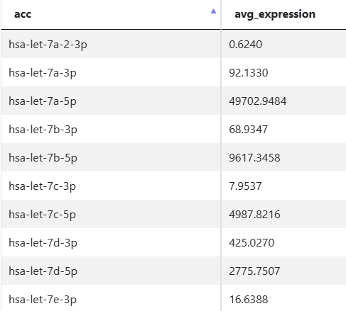
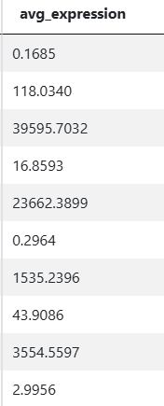
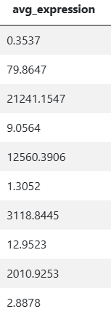
Lung:
Spleen:
Gut:

Slide 5
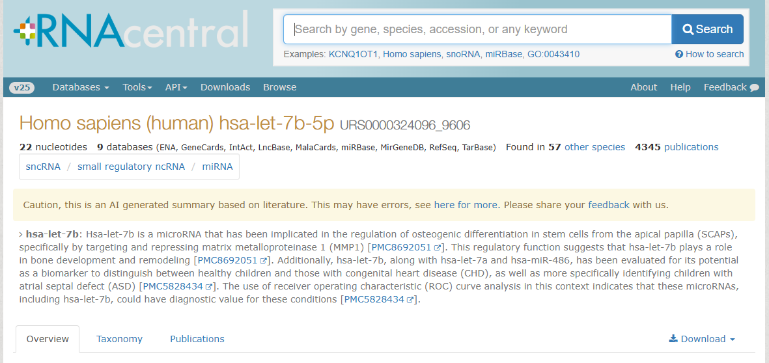
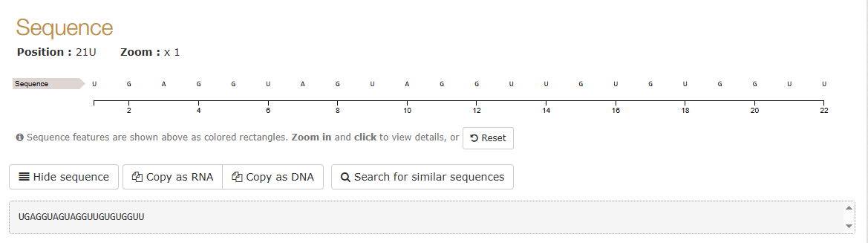
Integrates ncRNA information from over 40 databases (like miRBase, Ensembl, RefSeq, Rfam, etc.)

Slide 6
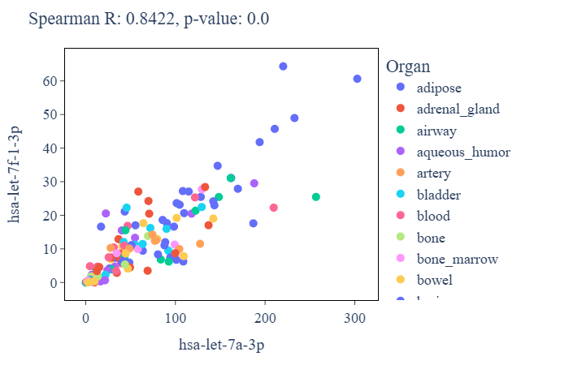
miRNA correlation:
How the expression of two miRNAs correlates across various organs.
Each point represents the expression values (RPMM) of both miRNAs in a specific organ.
If the two miRNAs are co-expressed ( both value are high) , indicates strong positive correlation.
Co-expression or Co-regulation
Potential biomarkers for specific diseases
R value +0.8 to +1.0 = Very strong correlation

Slide 7
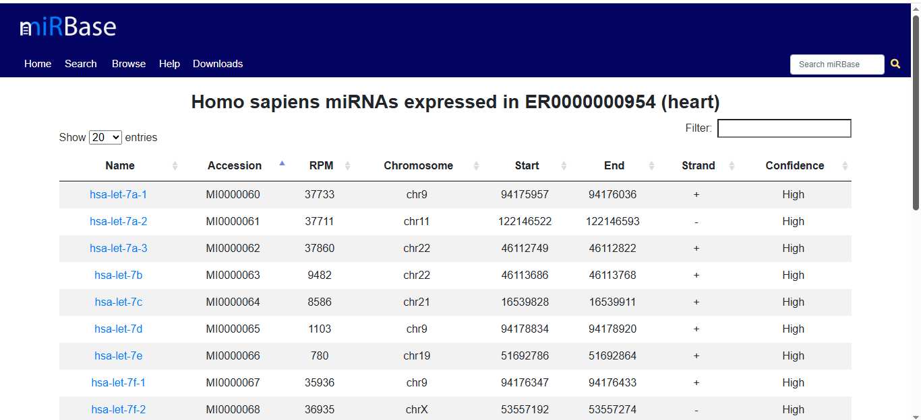
miRBase:

Slide 8
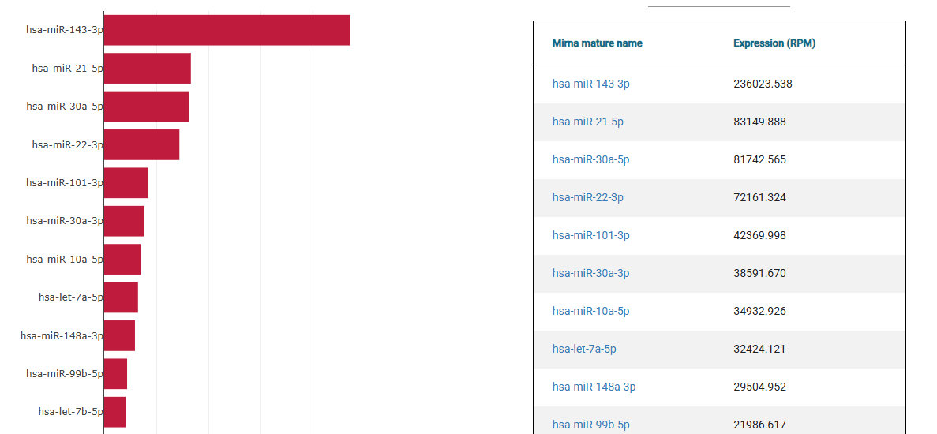
miTED:
Lung specific miRNAs

Slide 9
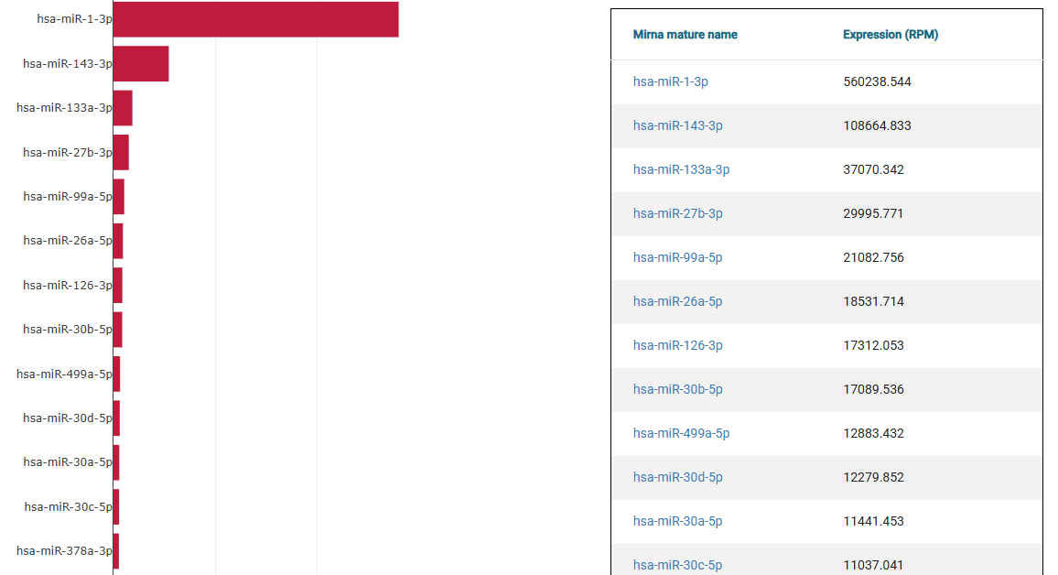
Heart specific miRNAs

Slide 11
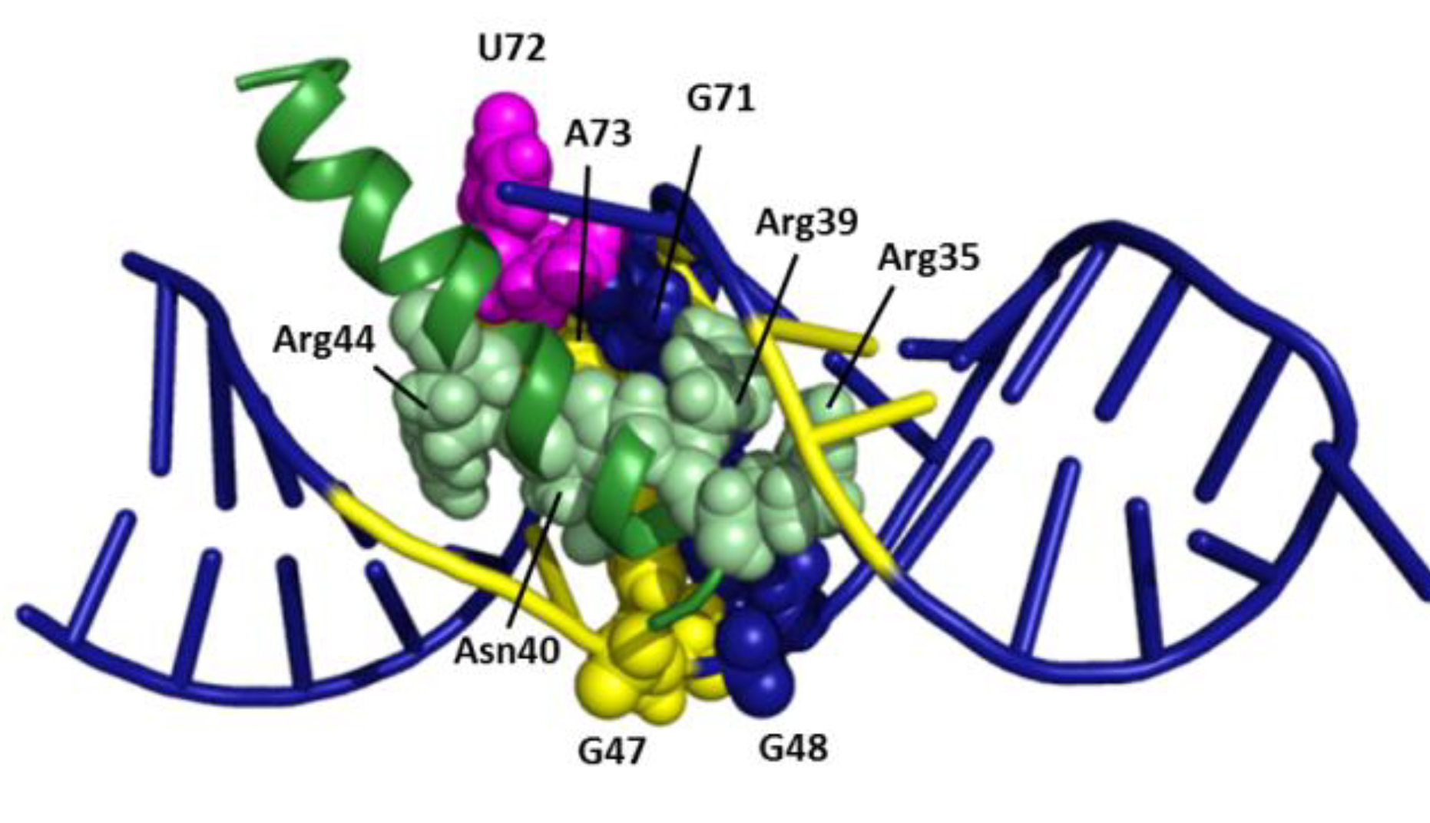
HIV-1 REV-RRE Complex Formation
REV
RRE
Terminate early infectious cycle
Viral Replication and Pathogenesis
ARM bound to Stem IIB
Blocking Rev-RRE Complex
ARM (REV)
Stem IIB (RRE)
Nuclear Export of Unspliced and Partially Spliced Viral RNA

Slide 15
